Slide 1


AI Powered Bot
This Photo by Unknown Author is licensed under CC BY-SA
©Kartikeya

Slide 2
Creating Intents
Intents Capture the User Goals
Starting with #
Min. give 5 examples
©Kartikeya

Slide 3
Creating Entities
Capture specific values in the user input
Start with @
Give multiples Synonyms
©Kartikeya

Slide 4
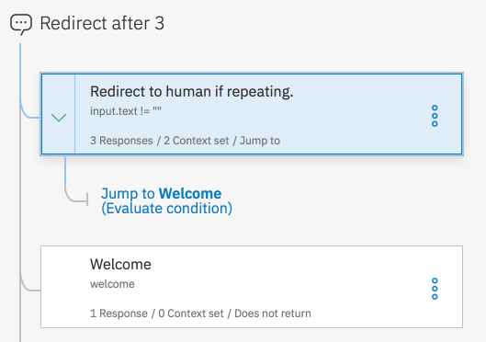
Creating Dialog Box
This Photo by Unknown Author is licensed under CC BY-SA
©Kartikeya

Slide 5
Thank You
©Kartikeya

